Slide 1
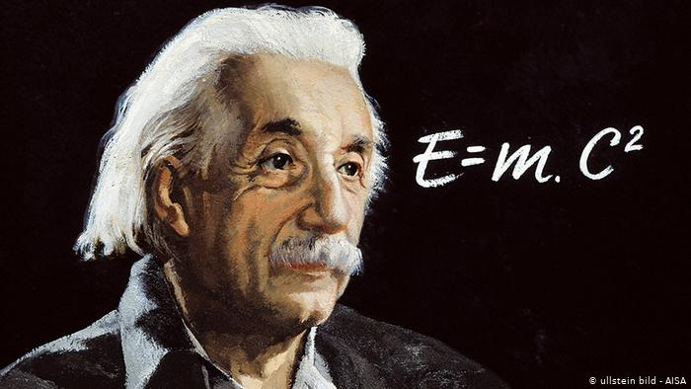
ATOMIC ENERGY CENTRAL SCHOOL-04, RAWATBHATA.
CLASS : XII
SUBJECT : PHYSICS
CHAPTER : 11
“DUAL NATURE OF RADIATION AND MATTER”.
MODULE-3
Presented By : Ms Soniya Moreshwar Sayam
(PGT-PHYSICS)

Slide 2
Topics to be discussed ……
Applications of photoelectric effect
Applications of photoelectric Cell
Photon
De Broglie wave
De Broglie wavelength for electron
Conclusion

Slide 3
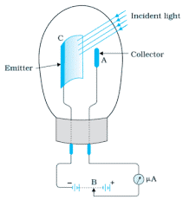
APPLICATIONS OF PHOTOELECTRIC EFFECT PHOTOELECTRIC CELL:
A device which converts light energy into electrical energy is called photoelectric cell. It is also called as photocell or electric eye.
When a radiation of suitable frequency is made
to fall on cathode, photoelectrons are emitted,
which are attracted by the anode.
Anode is kept at positive potential with respect
to cathode.
This arrangement results in the flow of
current when the radiation falls on the metal
surface. This current can be measured using the microammeter.

Slide 4
APPLICATIONS OF THE PHOTOELECTRIC CELLS:
Photoelectric cells are used in the television camera for telecasting scenes and are also used in the photo-telegraphy.
Photocells are used for sound recording and video recording.
It is used in burglar alarms and fire alarms.
It is used in the counting machines.
Photocells are also used to measure the temperature of stars and study their spectrum.
They are used to switch on and off the streetlight without any manual attention.
They are used in the photometry to compare the illuminating powers of the two sources.
They are used to locate minor flaws in metallic sheets.
They are used to determine the opacity of solids and liquids.
They are used to sort out the materials of different shades.
They are used to control the temperature of the chemical reactions.
They are used for the determination of the Planck’s constant.

Slide 5
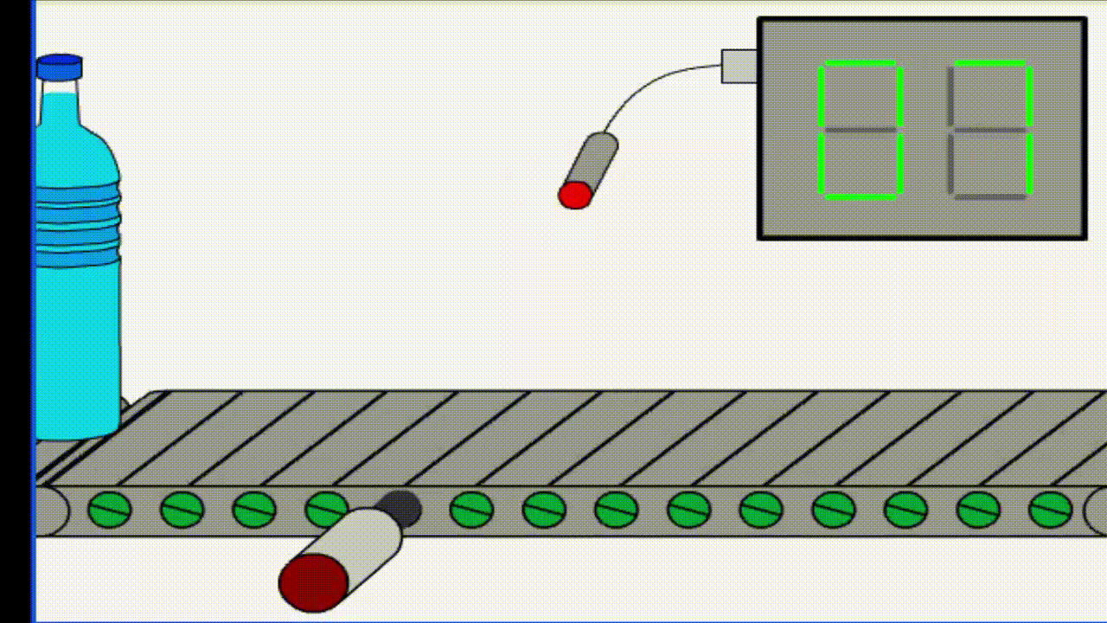
APPLICATIONS OF THE PHOTOELECTRIC CELLS:
It is used in the counting machines.

Slide 6
APPLICATIONS OF THE PHOTOELECTRIC CELLS:
It is used in burglar alarms and fire alarms.

Slide 7
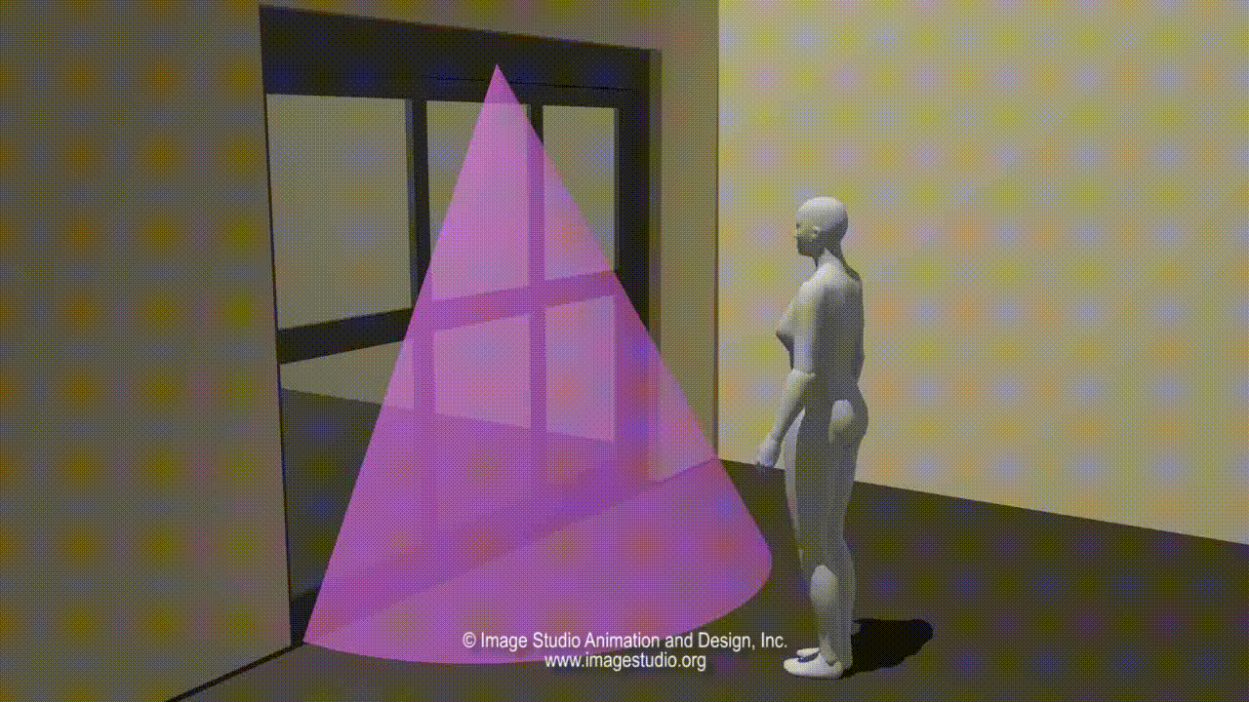
APPLICATIONS OF THE PHOTOELECTRIC CELLS:
Automatic door opener system:

Slide 8
PHOTONS- PACKETS OF ENERGY
Electrically neutral, No effect of Electric field or magnetic field
Massless
Energy: $i)E= hν=\frac{hc}{λ}$ ii) Momentum: p = $\frac{h}{λ}$
Energy and Momentum depends only on Frequency (or wavelength).
When photon collides with particle, then Total momentum will remain conserved like any other normal collision. But some photos may die in collision (Number of photon may change after Collison)
All photons possess same energy irrespective of intensity of light. Increase in intensity only increases the no. of photons.

Slide 9
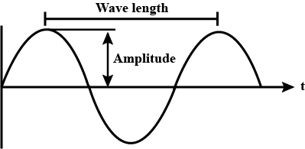
DE BROGLIE WAVE
According to de Broglie, a moving material particle can be associated with a wave. i.e. a wave can guide the motion of the particle. The waves associated with the moving material particles are known as de Broglie waves or matter waves.
Expression for de Broglie wave: λ
According to quantum theory, the energy of the photon is : $E = hν =\frac{hc}{λ}$
According to Einstein’s theory, the energy of the photon is: $E = {mc}^{2}$
So, $λ = \frac{h}{mc} ;$where p = mc is momentum of a photon
$λ = \frac{h}{p}$
If instead of a photon, we have a material particle of mass m moving with velocity v, then the equation becomes $λ = \frac{h}{mv}$ which is the expression for de Broglie wavelength.

Slide 10
DE BROGLIE WAVELENGTH FOR ELECTRON:
As studied previously, de Broglie wavelength is given by:
$λ = \frac{h}{mc}$ or $λ = \frac{h}{p}$
The kinetic energy is related to momentum as :
$KE= \frac{1}{2}mv^{2}=\frac{m^{2}v^{2}}{2m}$ =$\frac{p^{2}}{2m}$
p = $\sqrt{2m(KE)}$
For electron Charge (e); (Kinetic Energy ): $KE = eV$
$λ = \frac{h}{p}$ = $\frac{h}{\sqrt{2m(KE)}}$ = $\frac{h}{\sqrt{2m(eV)}}$
$λ = \frac{1.227}{\sqrt{V}}$ nm (For Electrons only)

Slide 11
CONCLUSION :
de Broglie wavelength is inversely proportional to the velocity of the particle.
If the particle moves faster, then the wavelength will be smaller and vice versa.
If the particle is at rest, then the de Broglie wavelength is infinite. Such a wave can not be visualized.
de Broglie wavelength is inversely proportional to the mass of the particle. The wavelength associated with a heavier particle is smaller than that with a lighter particle.
de Broglie wavelength is independent of the charge of the particle. Matter waves, like electromagnetic waves, can travel in vacuum and hence they are not mechanical waves.
Matter waves are not electromagnetic waves because they are not produced by accelerated charges.

Slide 12
TO BE CONTINUED…
THANK YOU FOR WATCHING!

